Slide 1

GIT

Slide 2



What is Git?
It’s a control version system to keep track of different versions of the files in a project folder.
When we type our code in a text editor and we save it, WE OVERWRITE THE PREVIOUS CODE VERSION!!!
What happens if we want to keep track of previous versions?
That’s where the Git comes to help.
Git allows you to register the changes in your files

Slide 3
GIT INSTALLATION AND CONFIGURATION

Slide 4
Configuring Git
In order to configure Git , you need to open your:
Terminal in Linux/MacOS
GitBash in Windows
And then you can type the following commands:
git # displays a list of basic commands with details
# Configuring git
git config --global user.name "<your name>"
git config --global user.email “<your_email_address>”
git config --list

Slide 5
Configuring Git
Changing the default text editor (recommended):
# MacOS users:
git config --global core.editor "/Applications/Sublime\ Text.app/Contents/SharedSupport/bin/subl --new-window --wait"
# Windows users type:
git config --global core.editor "'C:\Program Files\Sublime Text 3\sublime_text.exe' -w"

Slide 6


What is a repository?
Git repository: It’s a placeholder to store all the changes in any file of a project folder.
Each project must have it’s own project folder.
We might not have every project folder tracked with git.
Each git repo is independent of each other.

Slide 7
Creating a local repository
In order to start tracking files with Git locally, you need first to start a “repository” (repo) in a folder of your choice in your computer.
It’s very important to start git ONLY IN THE PROJECT FOLDER, NOT THE MAIN FOLDER. DON’T DO IT RIGHT AFTER OPENING THE TERMINAL!!!!!
Open a (Linux Terminal, macOS Terminal, GitBash) and move to the project folder in which you want to create your first project.
terminal commands
Once you are the desired folder, we need to instruct Git to start a “repo” (only do it once for every project):
git init

Slide 8
Important notes
Once a repo is started in a folder:
all the files and folders within will be tracked by git (regardless of their type).
we will not have to initialize another repo inside.
If we want to remove a git repo, we only need to remove the hidden folder: .git

Slide 9
Important notice!
Each project should have it’s own folder and git repo, ie:
Project 1 -> Folder_1 -> repo_1
Project 2 -> Folder_2 -> repo_2
…
Use the python script to create the right folder structure for your bootcamp.

Slide 10
WORKING WITH GIT IN OUR LOCAL REPO

Slide 11
Steps to register files with git. Pro
To check out the what changes we have made, we type:
git status
We add the files to be registered to the “staging area” using:
git add file_name1, file_name2,...
We create a “commit” to register the changes of the files in the “staging area” using:
git commit -m “Commit message”
Once we made a commit the content of the “staging area” is flushed.

Slide 12
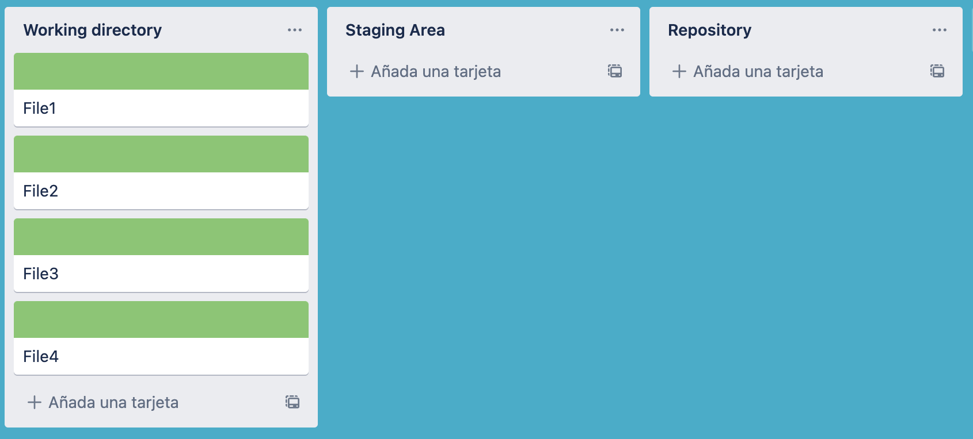
Process to create a “commit” Pro

Slide 13
Process to create a “commit” Pro
git status

Slide 14
Process to create a “commit” Pro
git add File1

Slide 15
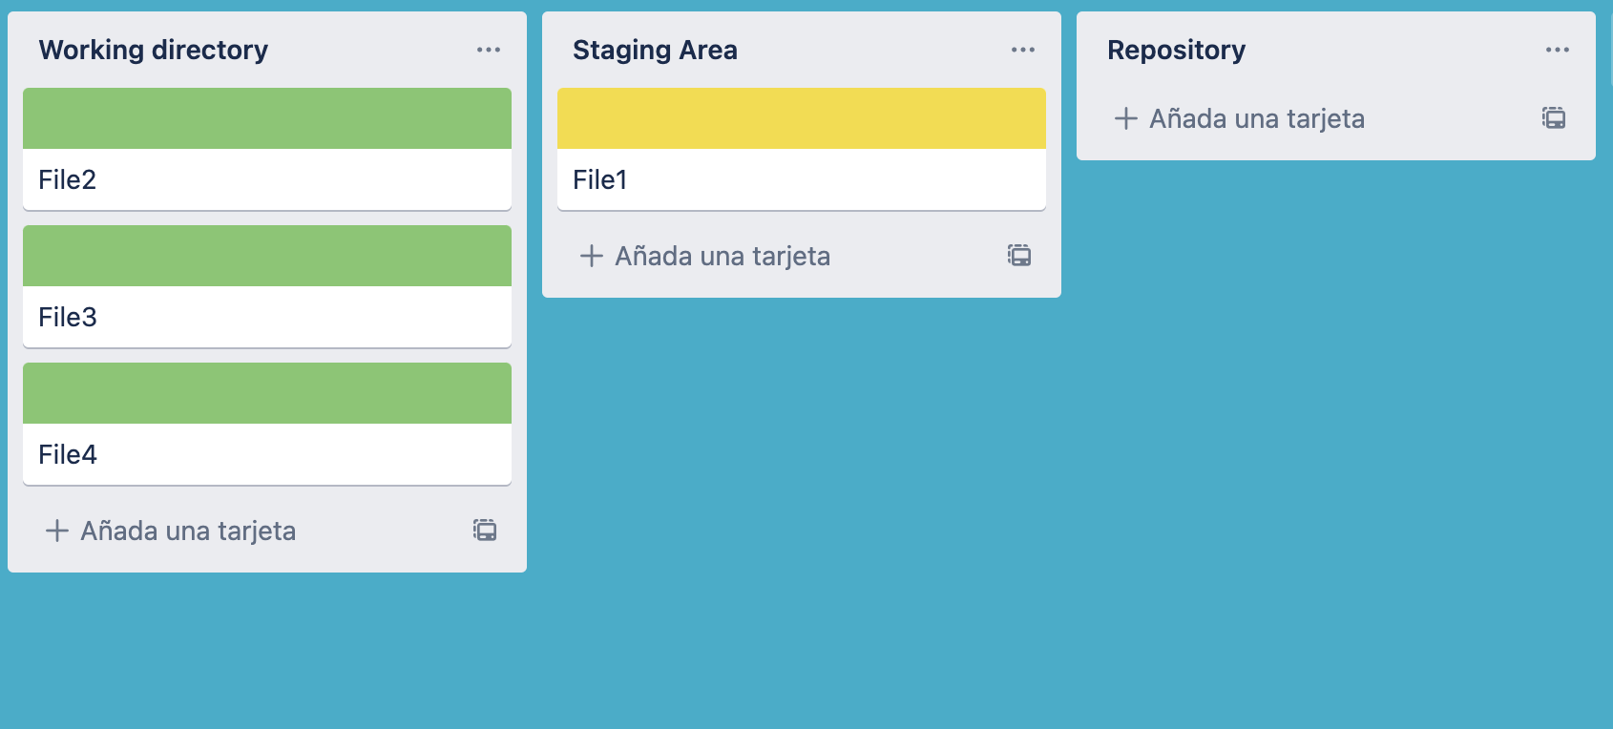
Process to create a “commit” Pro
git commit -m “Commit message”

Slide 16
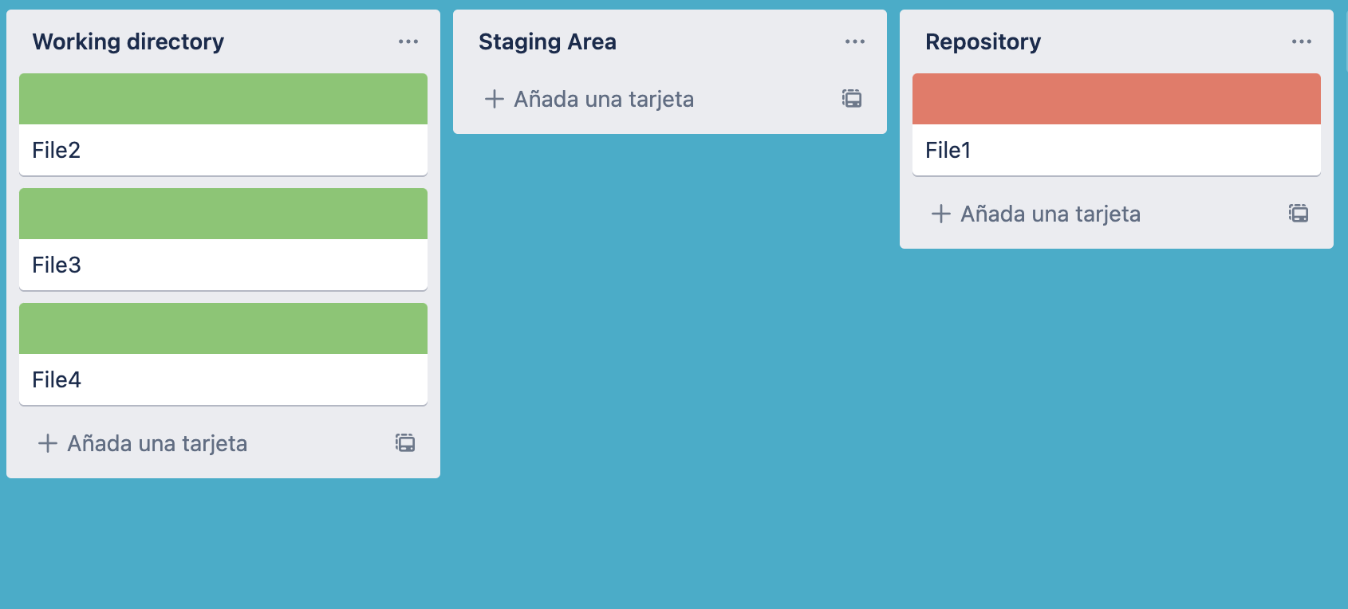
Process to create a “commit” Pro

Slide 17

History of commits: Pro
Once we created a “commit”, a history of commits will be created and updated every time a new commit is made.
We can check this history of commits by typing in the terminal:
git log
All the commits will appear in a chronological order from the most recent to the oldest one.
Each commit will have:
a unique alphanumeric identifier called “hash”,
the author:
the datetime
comment
branch

Slide 18
git log Pro
git log

Slide 19
GIT BRANCHES

Slide 20

Branches Pro
Sometimes we might want to develop new experimental code on top of our last commit to:
Solve a bug
Test new features
In such cases, we can create a new “BRANCH”. Which looks like a different version of the code in the same repo. Each branch has a unique name but nly one branch will be “active”.
We can create a new branch by using either:
git branch branch_name
git switch -c branch_name
We can change to an existing branch by using:
git switch branch_name
master
test

Slide 21
Merging branches and conflicts Pro
Every branch will start from the last commit of the current “active” branch.
Each branch can have as many commits as desired
Branches can be merged together by:
Switch to the destination branch:
git switch destination_branch
Merging the new branch:
git merge branch_to_be_merged
When we merge two branches, we can incidentally create a “conflict”, because the same section of one or more files has been modified in a different way by two developers.
In such cases, git will report us that there is a conflict on one or more files and it will edit the corresponding files adding some marks.

Slide 22
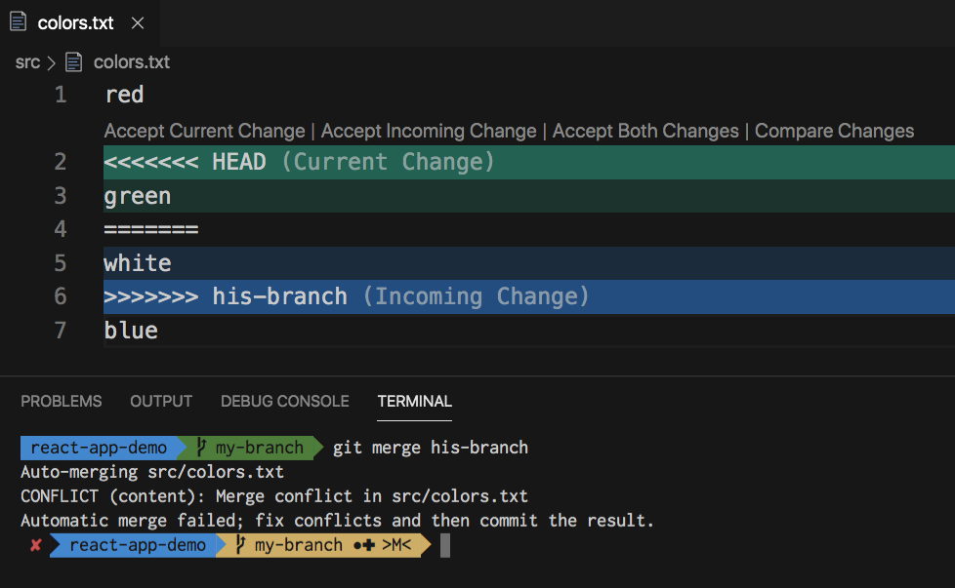
Branches: solving conflicts Pro
To solve this problem we need to:
Edit the file and remove the changes that we don’t want alongside with the marks <<<<<<HEAD ====== >>>>>>branch_name and save it.
git add modified_file
git commit -m “Merged branches and solving conflict”

